Slide 1
Scientific Computing lecture # 10 Chapter5 – part3 For Loops (5.3)

Slide 2
for loops vs. while loops
2
In while
we ask MATLAB to execute a block of code while a certain condition is true
In for loops
we ask MATLAB to execute a block of code for all values in a certain vector
Usually used to execute a block of code for a certain number of times

Slide 3
for loop syntax
3
The template for a for loop is:
for <variable> = <vector>
<code block>
end
How it works:
For each value in <vector>, assign the value to <variable> and execute the <code block>

Slide 4
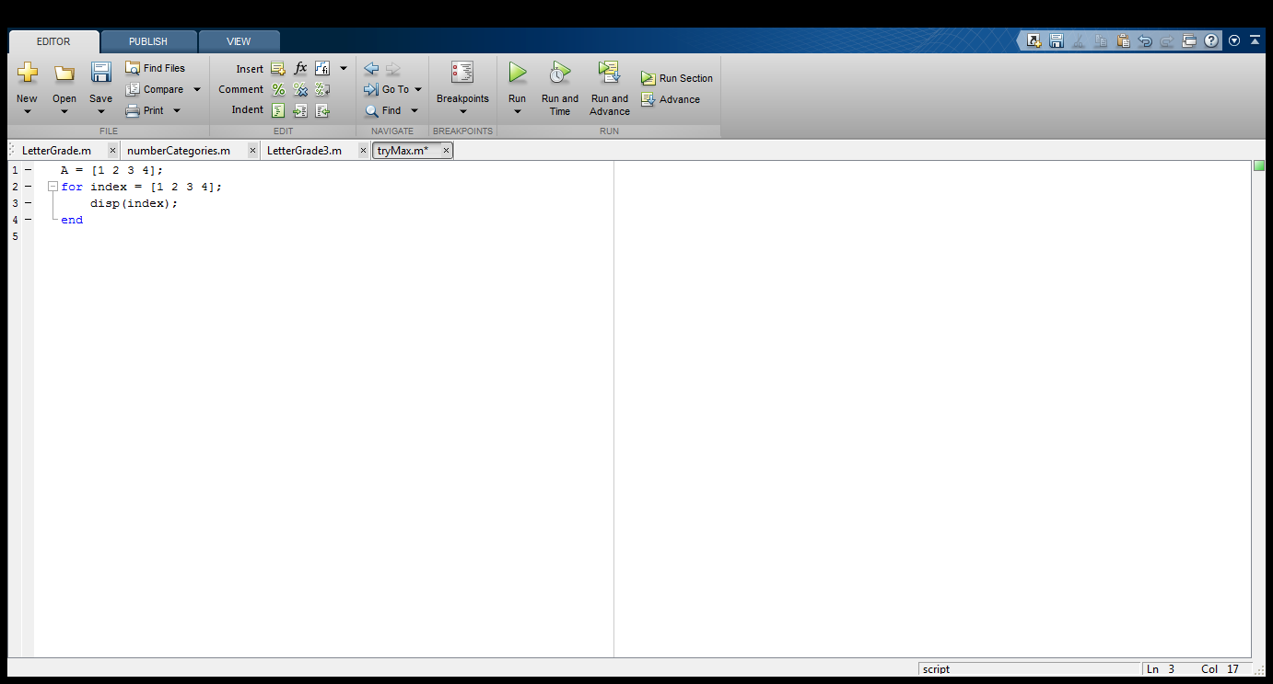
Simple for loop example
4
SimpleForLoop
>> SimpleForLoop
Workspace
index 1

Slide 5
Simple for loop example
5
SimpleForLoop
>> SimpleForLoop
1
Workspace
index 1

Slide 6
Simple for loop example
6
SimpleForLoop
>> SimpleForLoop
1
Workspace
index 2

Slide 7
Simple for loop example
7
SimpleForLoop
>> SimpleForLoop
1
2
Workspace
index 2

Slide 8
Simple for loop example
8
SimpleForLoop
>> SimpleForLoop
1
2
Workspace
index 3

Slide 9
Simple for loop example
9
SimpleForLoop
>> SimpleForLoop
1
2
3
Workspace
index 3

Slide 10
Simple for loop example
10
SimpleForLoop
>> SimpleForLoop
1
2
3
Workspace
index 4

Slide 11
Simple for loop example
11
SimpleForLoop
>> SimpleForLoop
1
2
3
4
Workspace
index 4

Slide 12
A for loop can be any of the following
12
for k= [1,3,7,8,9,11]
disp(k)
end
for k = 1:4
disp(k)
end
for k = 2:0.5:3
disp(k)
end
for k = 0:-2:-7
disp(k)
end
k takes on the values one by one
Implied increment of 1
Values of k : 1 2 3 4
real number increment
Values of k: 2 2.5 3
Negative increment
Values of k: 0 -2 -4 -6

Slide 13
A for loop can be any of the following
13
Outputs
for k= [1,3,7,8,9,11]
disp(k)
end
for k = 1:4
disp(k)
end
for k = 2:0.5:3
disp(k)
end
for k = 0:-2:-7
disp(k)
end
1
3
7
8
9
11
1
2
3
4
2 2.5000 3
0 -2 -4 -6

Slide 14
14
14
Do we have to use the loop index inside the loop?
No – sometimes it just serves as a counter
Example 2:
A program used in printing flyers that reads a number n and prints the phrase ‘Welcome Huskies’ n times

Slide 15
Example 2
Write a program, in MATLAB editor, used in printing flyers that reads a number n from the user and prints the phrase ‘Welcome Huskies’ n times
k is not used in the loop body!
n = input(‘Enter the number of lines’);
% prints a greeting n times
for k= 1:n
% print the greeting
disp('Welcome Huskies')
end

Slide 16
Example 3
16
Write a program in MATLAB editor to Calculate the average of 4 numbers
% Average 4 numbers from user input
n= 4; % number of data values
total = 0;
for k= 1:n
% read and process input value
num= input('Enter a number: ');
total= total + num;
end
avrg = total/n; % average of n numbers
fprintf('Average is %f\n', avrg)
Initialize your variables in which the total will be accumulated

Slide 17
Another way !
17
Write a program, in MATLAB editor to save the values entered by the user in a vector of values then use the built in function mean() !
The loop is used to read the values
% Average 4 numbers from user input
n= 4; % initialize the number of data values
numbers = [];
for k= 1:n
% read and save input value
num= input('Enter a number: ');
numbers = [numbers num]
end
avrg = mean(numbers); % average of n numbers
fprintf('Average is %f\n', avrg)

Slide 18
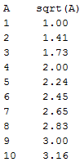
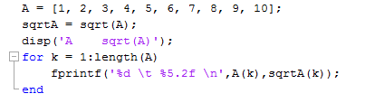
Example 4
18
Write a program in MATLAB editor, to print a two column table. The first column is a vector A that consist of numbers between 1 and 10 , and their square roots in the second column. Use fprintf inside a for loop for better control of the order in which elements are printed.
returns the number of
elements in A
Send the values 2 at a time

Slide 19
Any Questions

